Slide 1

Event-driven Programming

Slide 2
Learning Objectives
Understand the concept of event functions in Unity
Identify key event functions and their execution order
Learn how to use event functions to create interactive game experiences
Have an overview of Unity Job System
Understand the concept of serialization in Unity

Slide 3
Event Functions in Unity
Event functions are built-in methods in Unity's MonoBehaviour class that are called at specific points during the game's lifecycle. These functions allow you to execute code at precise moments, such as when an object is created, updated, or destroyed.
In Unity, scripts don't run continuously like traditional programs. Instead, they respond to specific events triggered by the game engine. This event-driven approach allows for efficient and flexible game development.
This lesson will explore the core concept of event functions in Unity, focusing on their execution order and how they can be used to create dynamic and interactive game experiences.

Slide 4
Event Functions in Unity
General Principles of Event Function Execution in Unity
Key Principles:
Unpredictable Order: The order of execution for event functions on different GameObjects is not guaranteed, except in specific cases.
Script Execution Order: You can control the order of execution for different MonoBehaviour subclasses using the Script Execution Order settings in the Project Settings window.
Scene-Specific Order: When loading multiple scenes additively, the script execution order is applied to each scene individually.

Slide 5
Event Functions in Unity
Execution Order
The order in which these event functions are executed is crucial for understanding and debugging your game's behavior. Here's a breakdown of the typical execution order:
1. Object Creation
2. Frame Update
3. Animation Update
4. Rendering
5. Object Destruction

Slide 6
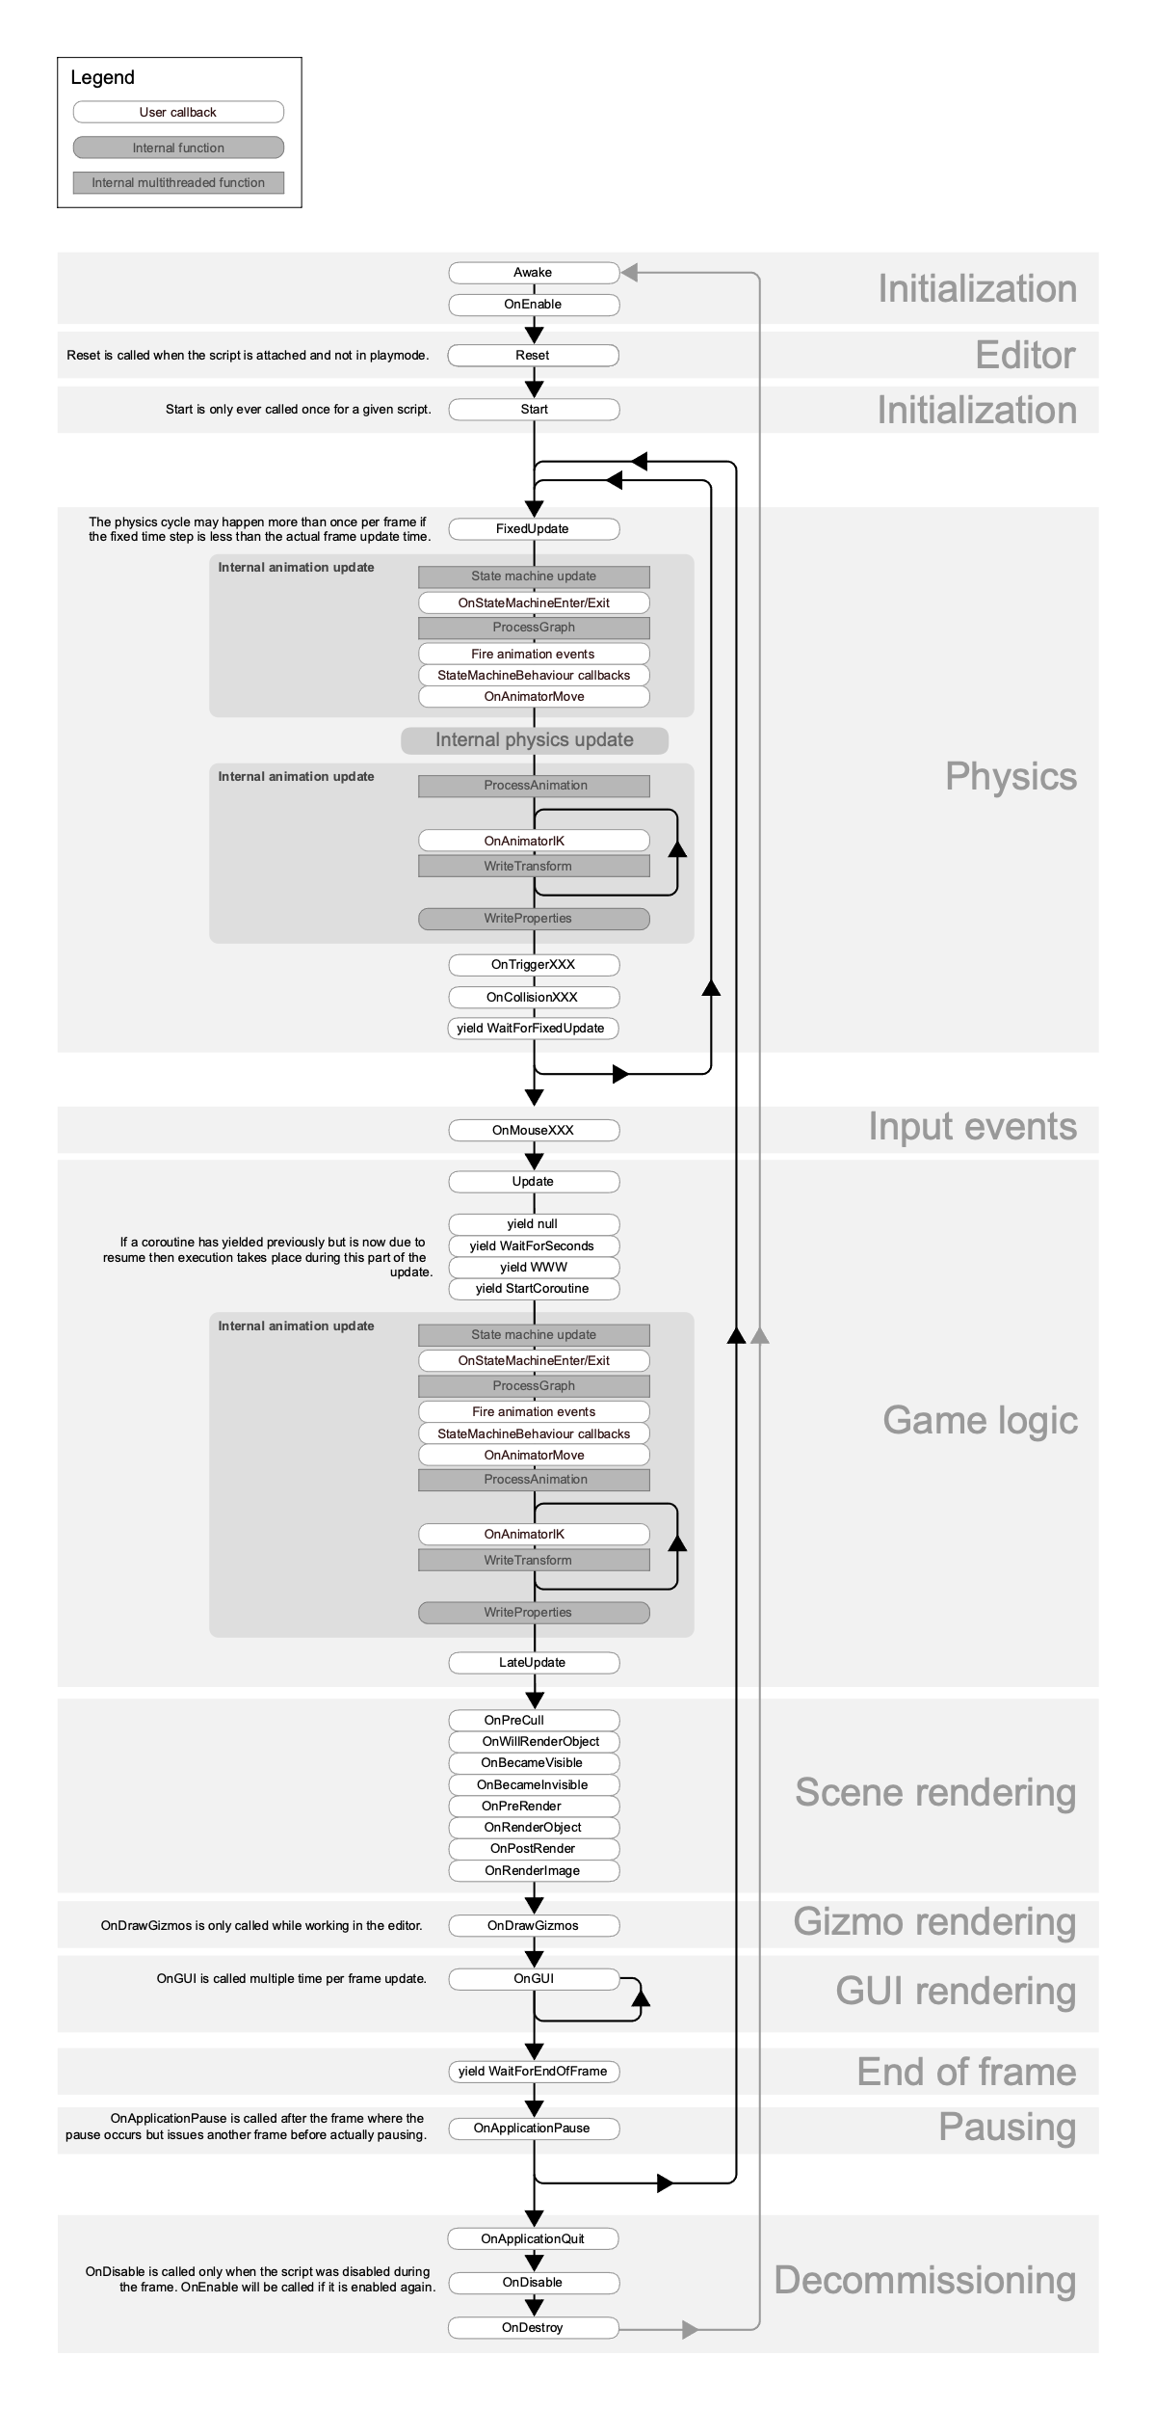
Event Functions in Unity
An Overview of Execution Order
Image link:
https://docs.unity3d.com/2023.1/Documentation/uploads/Main/monobehaviour_flowchart.svg

Slide 7
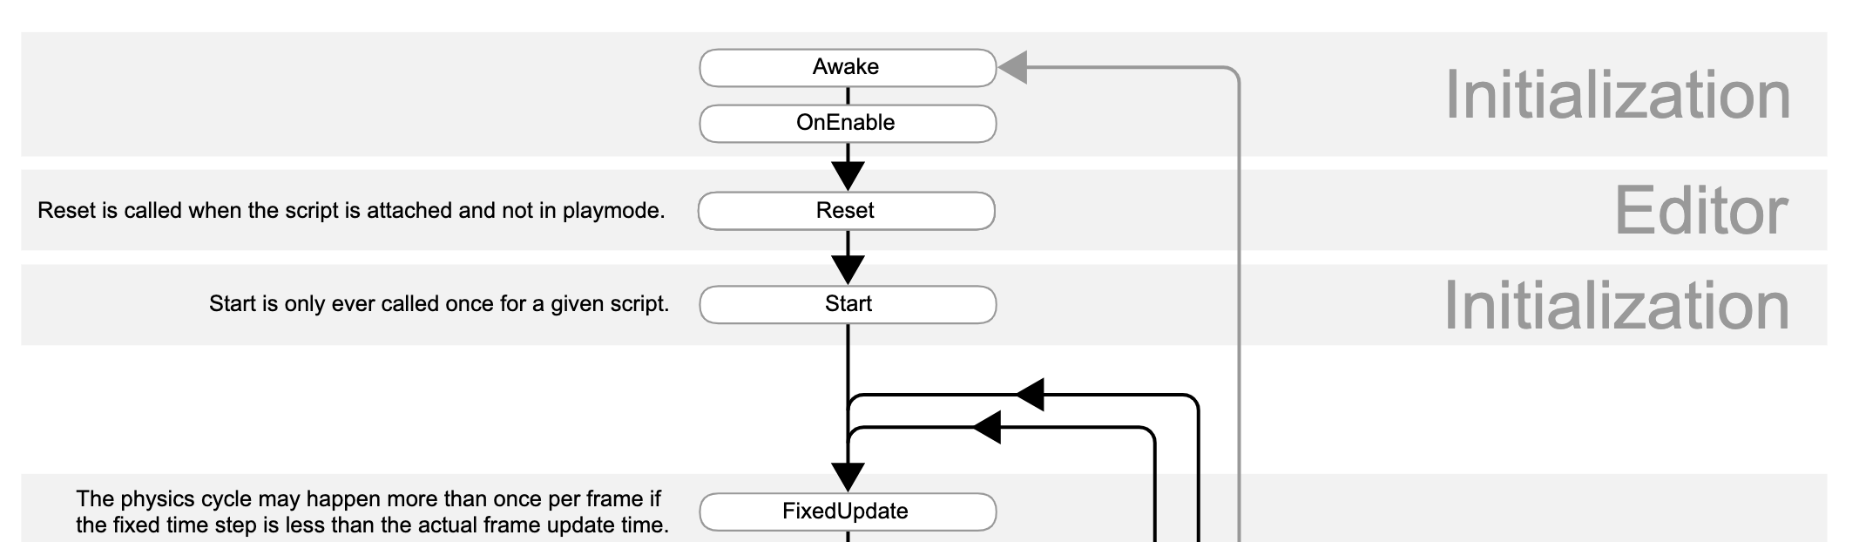
Event Functions in Unity
1. Object Creation
Awake: Called once when the object is created, even if it's initially inactive.
OnEnable: Called when the object becomes active.

Slide 8
Event Functions in Unity
2. Frame Update
FixedUpdate: Called at fixed intervals, independent of frame rate. Ideal for physics calculations.
Update: Called once per frame, for general game logic.
LateUpdate: Called after Update, often used for camera updates or post-processing effects.

Slide 9
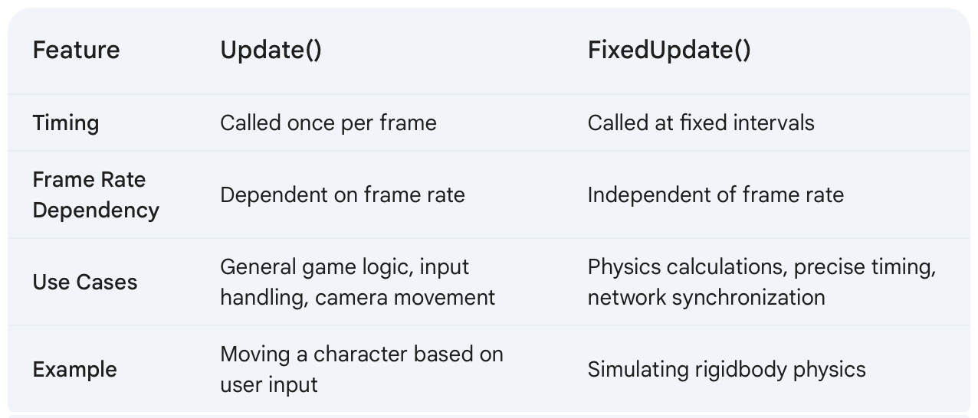
Event Functions in Unity
Update() vs FixedUpdate()

Slide 10
Event Functions in Unity
Update() vs FixedUpdate()
Choosing the Right Function:
Use FixedUpdate() for:
Physics calculations
Precise timing
Network synchronization
Use Update() for:
General game logic
Input handling
Camera movement
Most other game logic that doesn't require precise timing

Slide 11
Event Functions in Unity
3. Animation Update
OnAnimatorMove: MonoBehaviour.OnAnimatorMove is called before the animator applies root motion.
OnAnimatorIK: MonoBehaviour.OnAnimatorIK is called after the animator applies root motion.

Slide 12
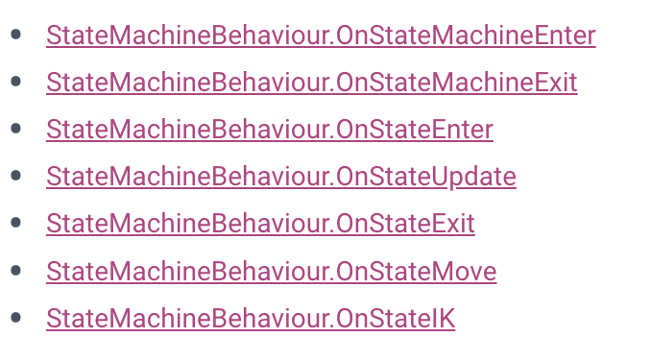
Event Functions in Unity
3. Animation Update (cont.)
Additional animation-related event functions are called on scripts that derive from StateMachineBehaviour:

Slide 13
Event Functions in Unity
4. Rendering
OnPreCull: Called before the camera culls objects.
OnBecameVisible/OnBecameInvisible: Called when an object becomes visible or invisible to the camera.
OnWillRenderObject: Called once per camera if the object is visible.
OnPreRender: Called before the camera starts rendering the scene.
OnRenderObject: Called after the scene is rendered, for custom rendering.
OnPostRender: Called after the camera finishes rendering.
OnGUI: Called multiple times per frame for GUI rendering.

Slide 14
Event Functions in Unity
4. Rendering
Unity provides a set of event functions that allow you to customize the rendering pipeline and perform custom rendering operations. These functions are typically called during the rendering process, allowing you to intervene at specific stages.

Slide 15
Event Functions in Unity
4. Rendering
OnPreCull: Called before the camera culls objects.
OnBecameVisible/OnBecameInvisible: Called when an object becomes visible or invisible to the camera.
OnWillRenderObject: Called once per camera if the object is visible.
OnPreRender: Called before the camera starts rendering the scene.
OnRenderObject: Called after the scene is rendered, for custom rendering.
OnPostRender: Called after the camera finishes rendering.
OnGUI: Called multiple times per frame for GUI rendering.

Slide 16
Event Functions in Unity
5. Object Destruction
OnDestroy: Called when the object is destroyed.
This function is called after all frame updates for the last frame of the object’s existence (the object might be destroyed in response to Object.Destroy or at the closure of a scene).

Slide 17
Event Functions in Unity
Additional event functions
Scene Load/Unload: SceneManager.sceneLoaded and SceneManager.sceneUnloaded events are triggered when scenes are loaded or unloaded.
RuntimeInitializeOnLoadMethodAttribute: Allows you to execute methods at specific stages of the scene loading process.
Coroutines: Used for asynchronous operations, allowing you to pause and resume execution.

Slide 18
Coroutines in Unity
What are Coroutines?
Coroutines are a powerful tool in Unity that allows you to pause and resume the execution of a function over multiple frames. This is particularly useful for creating time-based effects, asynchronous operations, and complex sequences of events.

Slide 19
Coroutines in Unity
How Coroutines Work:
1. Declaration: A coroutine is declared using the IEnumerator return type and the yield return statement.
2. Execution: When you call StartCoroutine, the coroutine starts executing.
3. Yielding: The yield return statement pauses the coroutine's execution until the specified condition is met. Common yield instructions include:
yield return null: Pauses execution for one frame.
yield return new WaitForSeconds(time): Pauses execution for a specific amount of time.
yield return new WaitForEndOfFrame: Pauses execution until the end of the current frame.

Slide 20
Coroutines in Unity
Key Points:
Asynchronous Operations: Coroutines are ideal for asynchronous operations like loading assets or making network requests.
Time-Based Effects: They can be used to create smooth transitions, animations, and time-based effects.
Efficient Scheduling: Coroutines are executed efficiently by Unity's event system.
Memory Overhead: Be mindful of memory usage when using many coroutines, as each coroutine has a memory overhead.

Slide 21
Coroutines in Unity
Best Practices:
Use Coroutines Wisely: Avoid using coroutines for simple tasks that can be handled in Update() or FixedUpdate().
Optimize Coroutines: Minimize the number of coroutines and yield instructions to improve performance.
Consider Alternatives: For some tasks, using Unity's built-in systems (e.g., animation, particle systems) or asynchronous programming techniques might be more efficient.

Slide 22
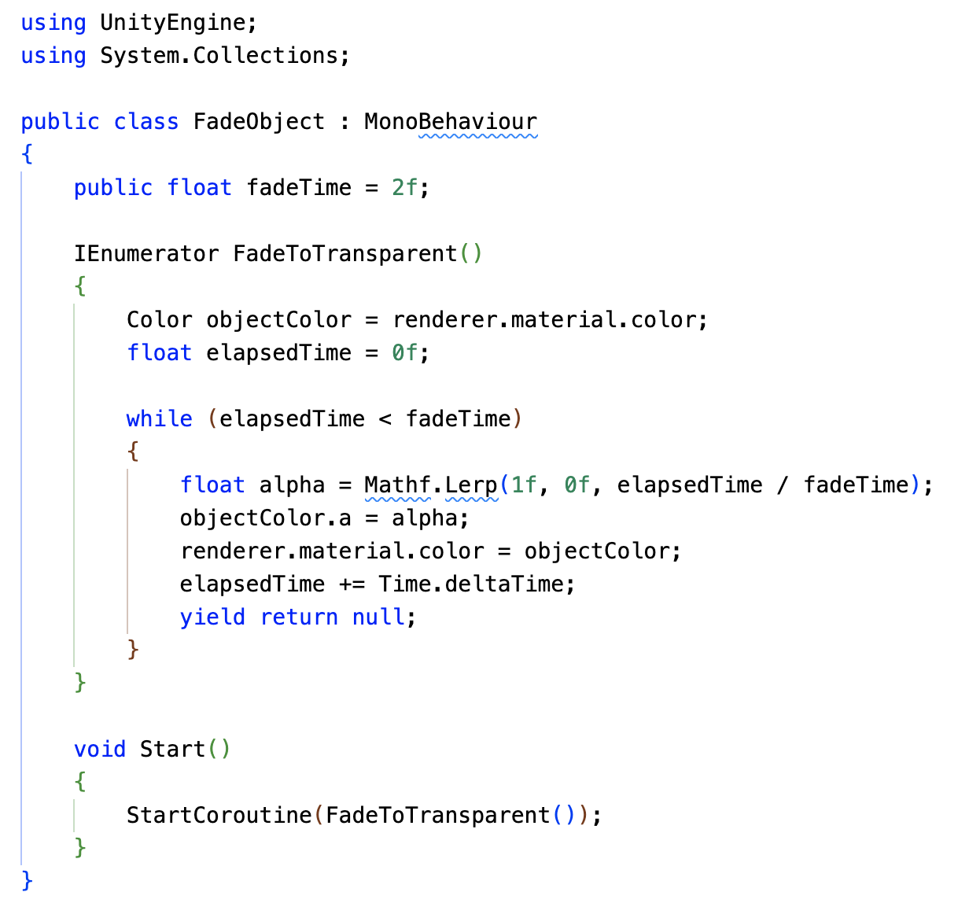
Coroutines in Unity
A Simple Coroutine Example: Fading an Object

Slide 23
Coroutines in Unity
A Simple Coroutine Example: Fading an Object
Explanation:
Coroutine Declaration: The FadeToTransparent method is declared with the IEnumerator return type, indicating it's a coroutine.
Color Fading: The for loop iterates over a specified time, gradually reducing the alpha value of the object's color.
Yielding: The yield return null statement pauses the coroutine's execution until the next frame.
Starting the Coroutine: The StartCoroutine method in the Start function initiates the coroutine.

Slide 24
Coroutines in Unity
Key Points:
Yielding: The yield return null statement is crucial for creating a smooth fading effect. It allows the coroutine to pause and resume execution on subsequent frames.
Time-Based Operations: The elapsedTime variable and Time.deltaTime are used to control the fading duration.
Flexibility: Coroutines can be used for various time-based effects, such as animations, delays, and asynchronous operations.

Slide 25
Coroutines in Unity
Remember:
Use coroutines judiciously to avoid performance overhead.
Break down complex tasks into smaller, more manageable coroutines.
Consider using asynchronous programming techniques for long-running operations to prevent blocking the main thread.
It’s important to remember that coroutines aren’t threads. Synchronous operations that run within a coroutine still execute on the main thread. If you want to reduce the amount of CPU time spent on the main thread, it’s just as important to avoid blocking operations in coroutines as in any other script code. If you want to use multi-threaded code within Unity, consider the C# Job System.

Slide 26
Unity Job System
What is the Job System?
The Unity Job System is a powerful tool that allows you to offload CPU-intensive tasks to multiple threads, significantly improving performance. By leveraging the capabilities of modern multi-core processors, you can maximize the potential of your Unity projects.

Slide 27
Unity Job System
Key Concepts:
Multithreading: The job system enables you to execute tasks in parallel, taking advantage of multiple CPU cores.
Work Stealing: The job system employs a work-stealing algorithm to efficiently distribute tasks among worker threads.
Data Safety: The system ensures data safety by copying data to prevent race conditions and data corruption.

Slide 28
Unity Job System
Key Concepts:
Multithreading: The job system enables you to execute tasks in parallel, taking advantage of multiple CPU cores.
Work Stealing: The job system employs a work-stealing algorithm to efficiently distribute tasks among worker threads.
Data Safety: The system ensures data safety by copying data to prevent race conditions and data corruption.

Slide 29
Unity Job System
Benefits of Using the Job System:
Improved Performance: Significant performance gains, especially for CPU-bound tasks like physics calculations, AI, and data processing.
Smoother Gameplay: Reduced frame rate drops and more consistent performance.
Enhanced Responsiveness: Faster loading times and more responsive user interactions.

Slide 30
Unity Job System
How to Use the Job System:
Identify CPU-Intensive Tasks: Pinpoint tasks that can benefit from parallelization, such as physics calculations, AI pathfinding, or data processing.
Break Down Tasks: Divide large tasks into smaller, independent jobs.
Create Job Structures: Define data structures for the jobs, ensuring they only contain blittable types.
Schedule Jobs: Use the JobHandle class to schedule jobs and wait for their completion.
Execute Jobs: The job system will automatically execute the jobs on available worker threads.

Slide 31
Unity Script Serialization
Understanding Serialization
Serialization is the process of converting data structures or object states into a format that can be stored or transmitted. In Unity, it's used to save and load scenes, assets, and game objects.

Slide 32
Unity Script Serialization
Key Points:
Field Serialization: Unity primarily serializes fields, not properties.
Supported Types: Unity can serialize primitive types, enums, arrays, lists, and certain Unity-specific types like Vector3 and Color.
Custom Classes: To serialize custom classes, mark them with the Serializable attribute.

Slide 33
Unity Script Serialization
Serialization Rules:
Public or SerializedField: Fields must be public or marked with the SerializeField attribute.
Non-Static and Non-Const: Fields cannot be static or const.
Supported Types: Only certain data types are supported, including primitive types, enums, arrays, lists, and Unity-specific types.

Slide 34
Unity Script Serialization
How Unity Uses Serialization:
Saving and Loading: Unity uses serialization to save and load scenes, assets, and game objects.
Inspector Window: The Inspector window displays and edits serialized data.
Hot Reloading: Unity serializes and deserializes script data during hot reloading.
Prefabs: Prefabs are serialized representations of GameObjects.
Instantiation: When instantiating a prefab, Unity deserializes its data to create a new GameObject.
Notes:
https://docs.unity3d.com/2022.3/Documentation/Manual/script-Serialization-BuiltInUse.html

Slide 35
Recap
Event Functions
Core Concept: Event functions are methods triggered by Unity at specific points in the game's lifecycle.
Execution Order: Understanding the order of execution is crucial for correct game behavior.
Key Events:
Awake, OnEnable, Start: Object initialization.
Update, FixedUpdate, LateUpdate: Frame updates.
OnAnimatorMove, OnAnimatorIK: Animation-specific events.
OnPreCull, OnWillRenderObject, OnPreRender, OnPostRender, OnGUI: Rendering events.
OnDestroy: Object destruction.

Slide 36
Recap
Coroutines
Asynchronous Operations: Coroutines allow you to pause and resume execution, enabling asynchronous tasks.
Time-Based Effects: They're ideal for creating timed effects and animations.
Yield Instructions: yield return null, yield return new WaitForSeconds, and yield return new WaitForEndOfFrame are commonly used to control coroutine execution.

Slide 37
Recap
Unity Job System
Parallel Processing: The Job System enables you to offload CPU-intensive tasks to multiple threads, improving performance.
Key Concepts:
Job Structure: Defines the work to be done.
Job Scheduling: Schedules jobs for execution on worker threads.
Data Safety: Ensures data integrity by copying data to avoid race conditions.
Benefits: Improved performance, smoother gameplay, and faster loading times.

Slide 38
Recap
Unity Script Serialization
Data Persistence: Serialization converts data structures into a format that can be stored and loaded.
Field Serialization: Unity primarily serializes fields, not properties.
Custom Serialization: Use ISerializationCallbackReceiver to customize serialization and deserialization.
Best Practices: Minimize serialized data, avoid redundant data, and use serialization callbacks effectively.

